Slide 1
Recitation 3

Slide 2

1.3 #3

Slide 3
Answers
a)
b)
p | q | p ∨ q | q ∨ p
T | T | T | T
T | F | T | T
F | T | T | T
F | F | F | F
p | q | p ∧ q | q ∧ p
T | T | T | T
T | F | F | F
F | T | F | F
F | F | F | F

Slide 4
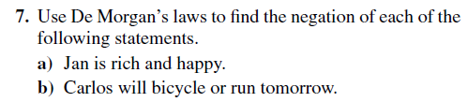

1.3 #7

Slide 5
Answers
a) Jan is not rich or not happy.
b) Carlos will not bike and will not run tomorrow.
c) Mei does not walk and does not take the bus to class.
d) Ibrahim is not smart or not hard working.

Slide 6
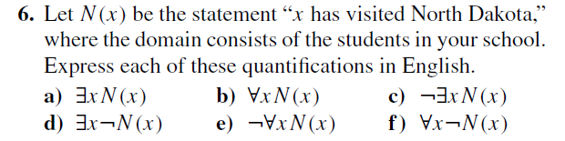
1.4 #6

Slide 7
Answers
a) There exists a student in my school that has visited North Dakota.
b) All students in my school have visited North Dakota.
c) There exists no student in my school who have visited North Dakota.
d) There exists a student in my school who has not visited North Dakota.
e) Not all of the students in my school have visited North Dakota.
f) All students in my school have not visited North Dakota.

Slide 8
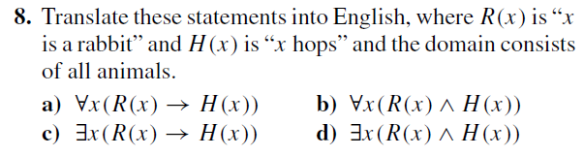
1.4 #8

Slide 9
Answers
a) Every rabbit hops.
b) All animals are rabbits and all animals hop.
c) There exists an animal such that if it is a rabbit, then it hops.
d) There exists a rabbit that hops.

Slide 10
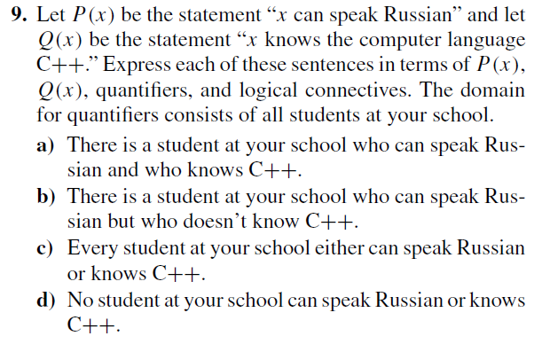
1.4 #9

Slide 11
Answers
a) ∃x(P(x) ∧ Q(x))
b) ∃x(P(x) ∧ ¬Q(x))
c) ∀x(P(x) ∨ Q(x))
d) ∀x(¬P(x) ∨ ¬Q(x))

Slide 12
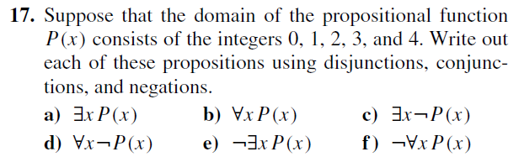
1.4 #17

Slide 13
Answers
a) P(0) ∨ P(1) ∨ P(2) ∨ P(3) ∨ P(4)
b) P(0) ∧ P(1) ∧ P(2) ∧ P(3) ∧ P(4)
c) ¬P(0) ∨ ¬P(1) ∨ ¬P(2) ∨ ¬P(3) ∨ ¬P(4)
d) ¬P(0) ∧ ¬P(1) ∧ ¬P(2) ∧ ¬P(3) ∧ ¬P(4)
e) ¬P(0) ∧ ¬P(1) ∧ ¬P(2) ∧ ¬P(3) ∧ ¬P(4)
f) ¬P(0) ∨ ¬P(1) ∨ ¬P(2) ∨ ¬P(3) ∨ ¬P(4)

Slide 14
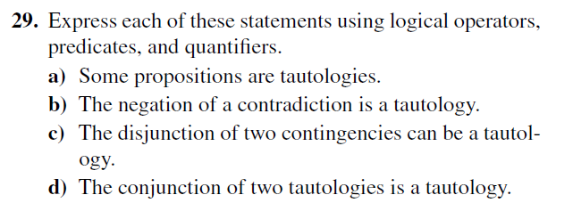
1.4 #29

Slide 15
Answers
C(x) = x is a contradiction, T(x) = x is a tautology, N(x) = x is a contingency
Let the domain of x be all propositions (thus x is a proposition)
a) ∃xT(x)
b) ∀x(C(x) → T(¬x))
c) ∃x∃y(N(x) ∧ N(y) → T(x ∨ y))
d) ∀x∀y(T(x) ∧ T(y) → T(x ∧ y))

Slide 16
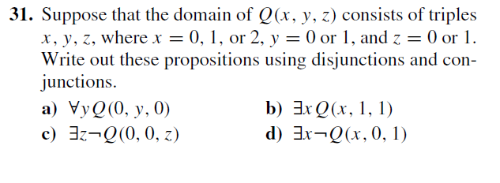
1.4 #31

Slide 17
Answers
a) Q(0,0,0) ∧ Q(0,1,0)
b) Q(0,1,1) ∨ Q(1,1,1) ∨ Q(2,1,1)
c) ¬Q(0,0,0) ∨ ¬Q(0,0,1)
d) ¬Q(0,0,1) ∨ ¬Q(1,0,1) ∨ ¬Q(2,0,1)

Slide 18
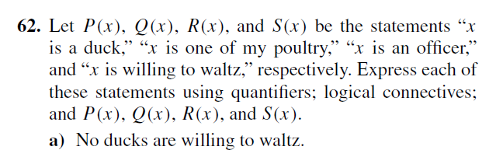
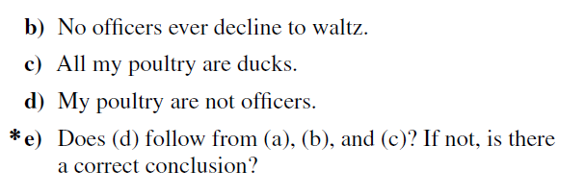
1.4 #62

Slide 19
Answers
a) ∀x (P(x) → ¬S(x))
b) ∀x(Q(x) → ¬S(x))
c) ∀x(Q(x) → ¬P(x))
d) ∀x (Q(x) → ¬R(x))
e) Yes. All my poultry are ducks and ducks do not waltz, which means they are not officers because officers do waltz

